Slide 1
Household and non-household transmission pre and post-lockdown

Slide 2
Restriction timeline
23 January, transport in Wuhan, Huanggang and Ezhou severely restricted, including closure of public transit, trains, airports, and major highways
24 January, travel restrictions enacted in 12 additional prefecture-level cities in Hubei
January 26th 2020
China extends the ‘Spring Festival’ holiday in order to contain the coronavirus outbreak.
Schools in Beijing to stay closed until further notice
13 February, the Chinese government has issued extension of order to shut down all non-essential companies, including manufacturing plants, in Hubei Province until at least 24:00 20 February.[24]
20 February, the Chinese government has issued extension of order to shut down all non-essential companies, including manufacturing plants, and all schools in Hubei Province until at least 24:00 10 March.[25]
13 March: Huangshi removes controls and permits on road traffic within its urban area;[6] Qianjiang does the same for its entire administrative area.[7]
March 19th 2020 For the first time, China reports zero local infections, a milestone in the fight against the pandemic. Experts said the country would need to see at least 14 consecutive days without new infections for the outbreak to be considered over. 34 new cases were confirmed among people who had arrived in China from elsewhere.

Slide 3
Chinese lunar Spring Festival (CSF)
Chinese lunar Spring Festival (CSF) or Easter Holidays, which have different Gregorian dates in different years. The beginning of the 2020 lockdown overlapped with the CSF. CSF, the most important Chinese national holiday, encompasses one week that includes over 30 billion trips across China since many people move from megacities to their hometowns, making “empty cities” during CSF a unique phenomenon in Chinese megacities.
On 26 January 2020, the Chinese State Council issued a circular extending the Spring Festival (Chinese New Year) holidays for workers to 2 February.
The Spring Festival holidays are originally scheduled to run from 24 to 30 January.
Numerous cities in the central Chinese province of Hubei, including its capital, Wuhan, as well as other cities outside Hubei province have been locked down indefinitely since the beginning of the Spring Festival holidays amid the outbreak of the new coronavirus.

Slide 4
School closures
In late January 2020, mainland China postponed all educational activities and the Chinese Ministry of Education (MoE) urged schools and higher education institutions to use online delivery as an alternative to face-to-face teaching.
In response to the call, the majority of provinces, municipalities and autonomous regions in mainland China pushed back the spring semester start date and transitioned to teaching classes online.
From April 2020, on-campus teaching began to gradually re-open for school students, starting with graduating classes in high schools (Years 9 and 12, as well as graduating classes of secondary vocational schools).[3] By 11 May, all mainland provinces/municipalities and autonomous regions had recommenced on-campus teaching for senior high schools and 26 permitted students back on campus in higher education institutions – meaning around 107.79 million students (~39% of China’s student population from kindergarten, primary and secondary school and higher education institutions) had returned to campus. [4]

Slide 5
Sources
Wikipedia…
British Foreign Policy Group
https://bfpg.co.uk/2020/04/covid-19-timeline/
Australian gov, dept of edu
https://www.dlapiper.com/en/us/insights/publications/2020/01/china-extends-holidays-for-workers-amid-coronavirus-outbreak/

Slide 6
Data overview
Original data set
1407 observations
Household/non-household
581 + 698 = 1279
known infector and infectee age, household info
H/NH, pre/post-lockdown
drop further to 332 + 328 = 660
household/non-household, age and with known infection onset dates
infector/infectee onset >= 23 Jan is lockdown

Slide 7
H/NH and pre-post lockdwon
Pre Post Total
Household 104 224 328
Non-household 110 222 332
Total 214 446
Household/non-household split is equal
But cases double after lockdown
Doubling is comparable in and outside of households

Slide 8
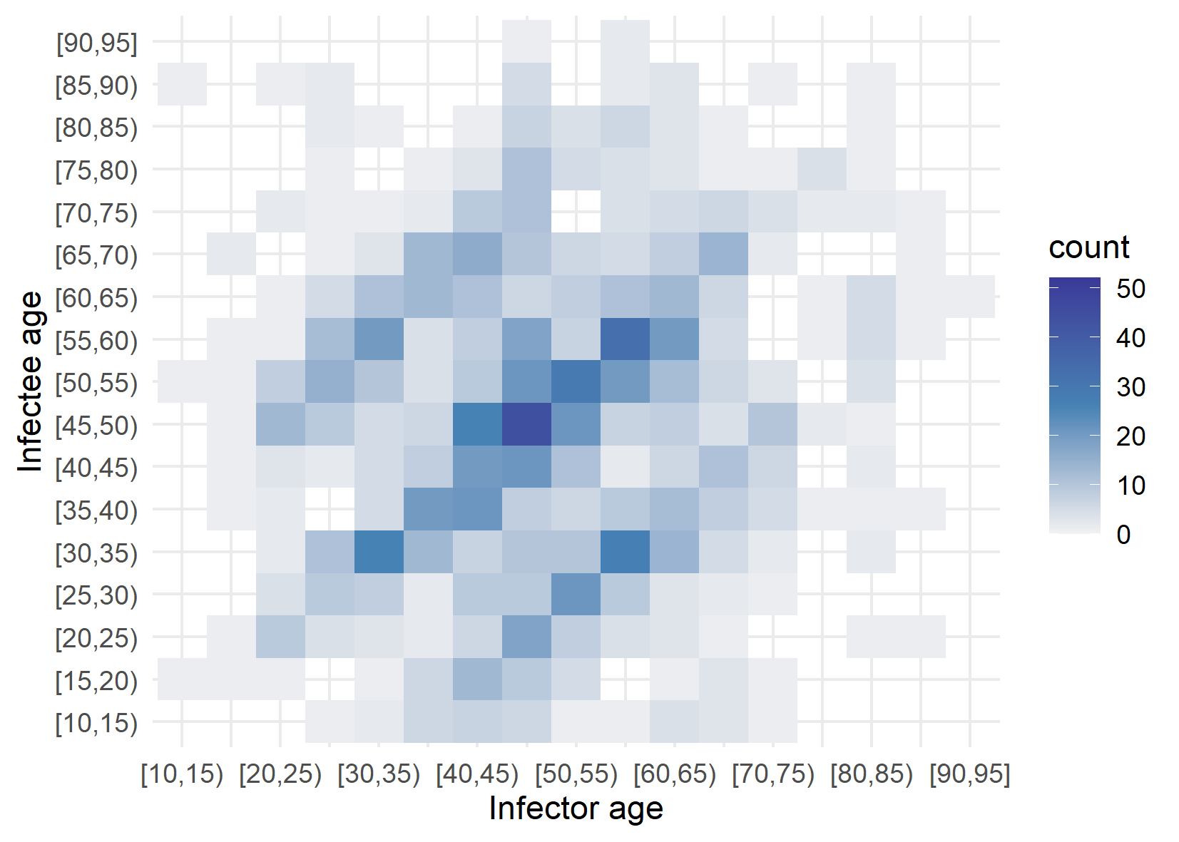
Overall age matrix

Slide 9
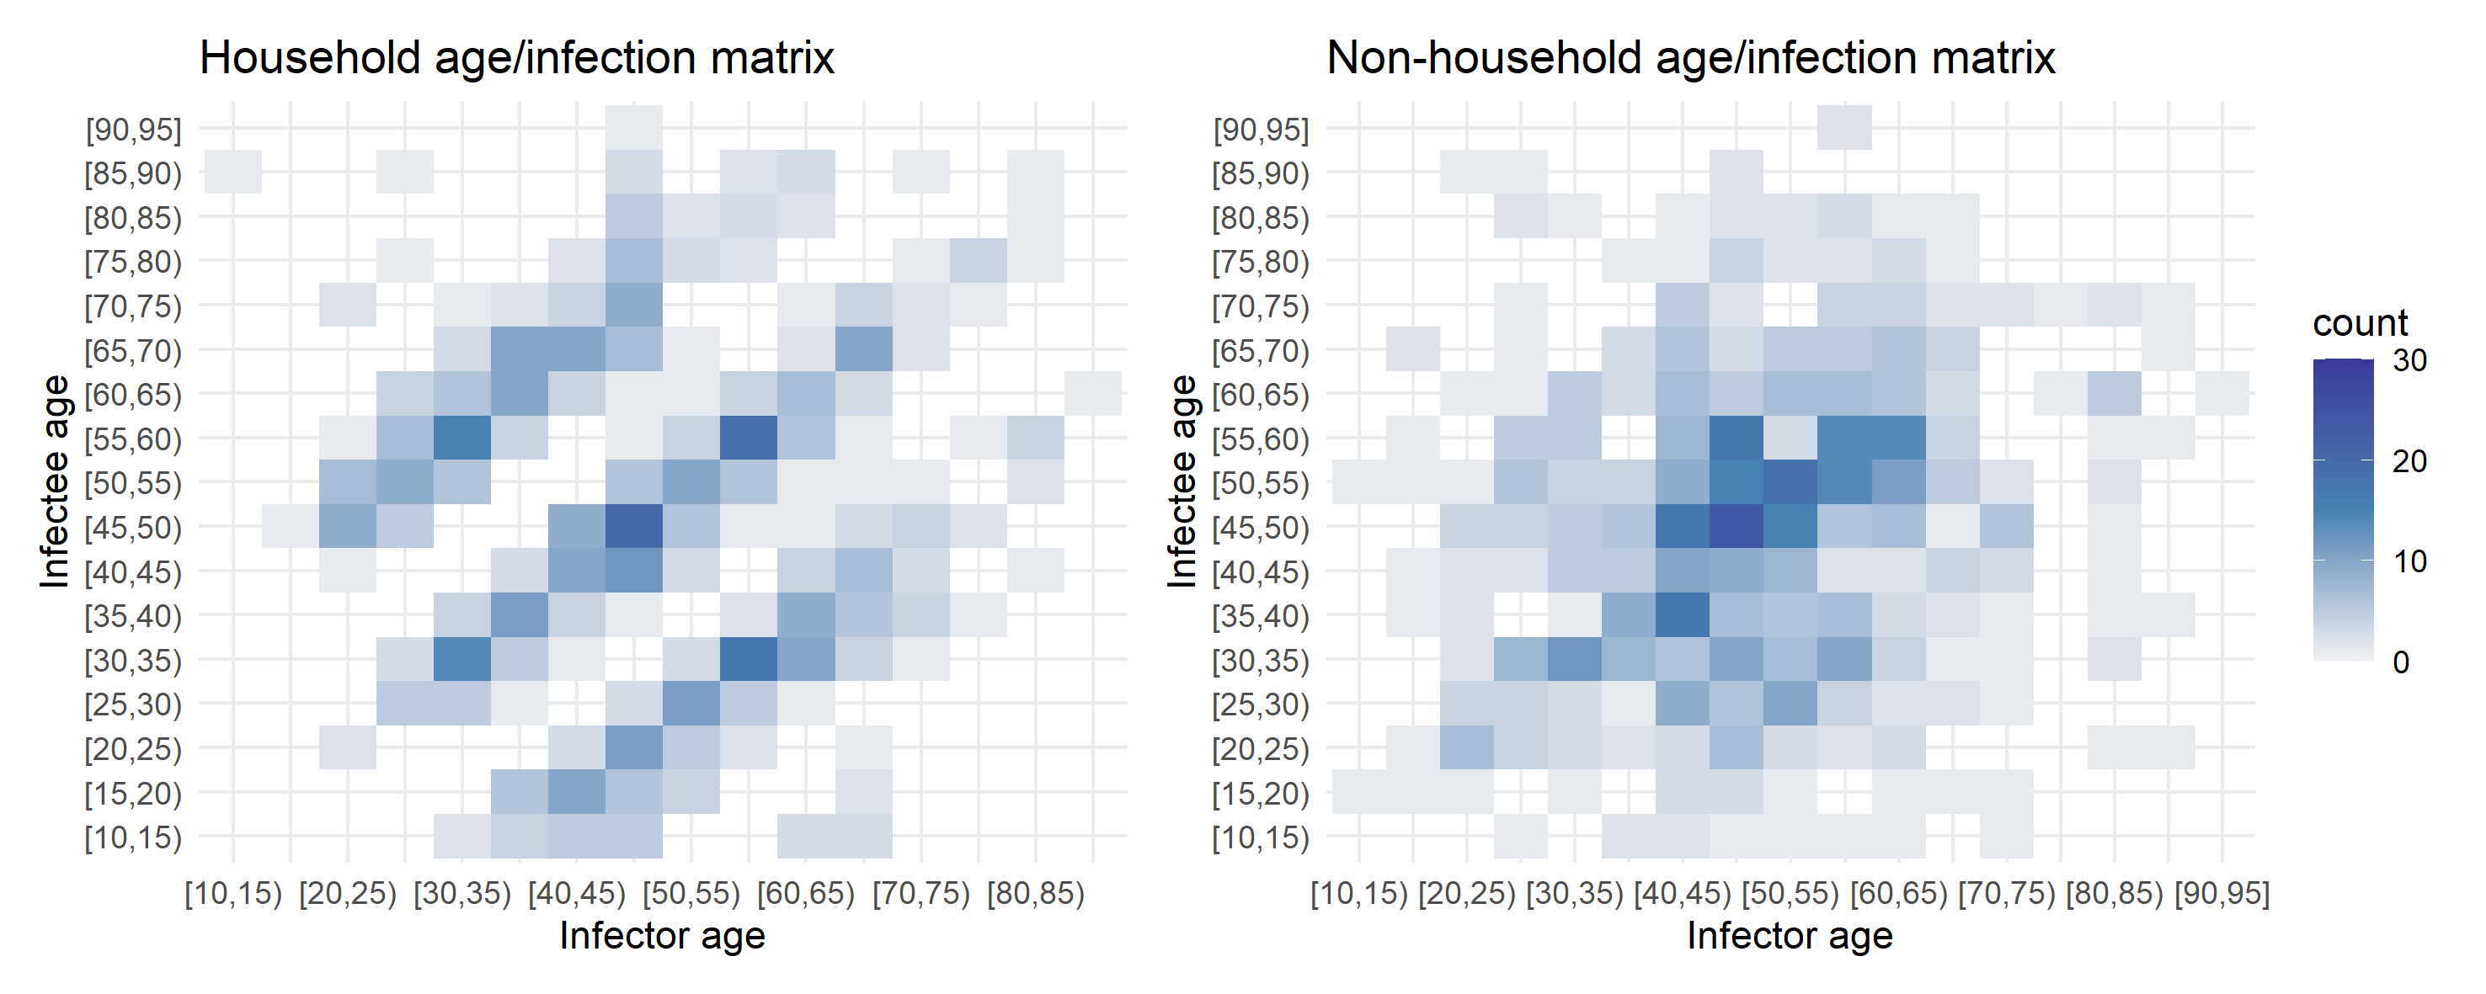
Household vs non-household

Slide 10
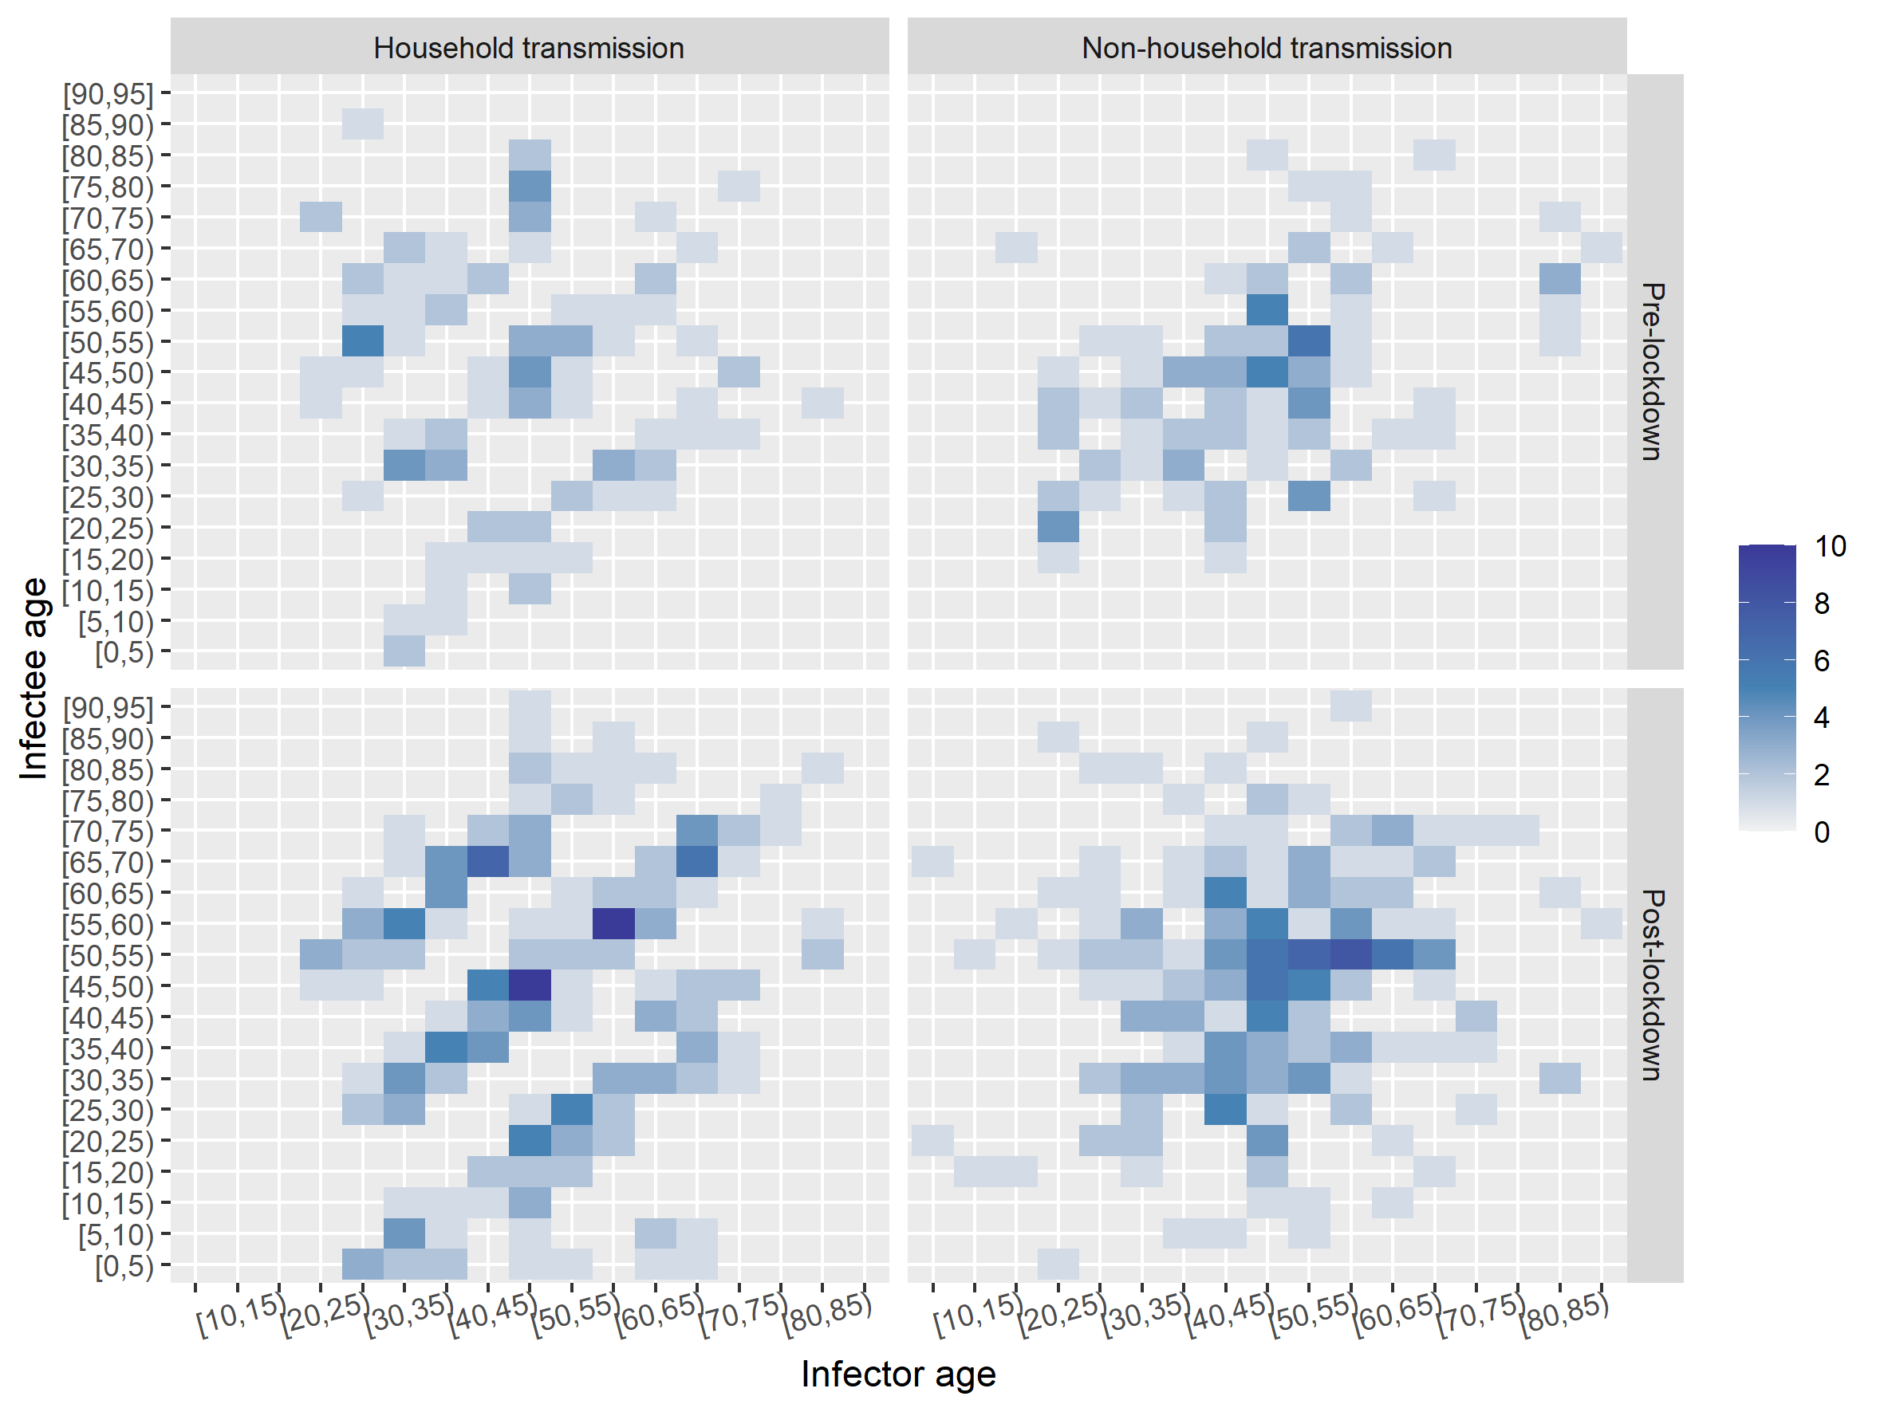
Where are all <20 year olds before lockdown?
Very few of them post-lockdown too…
Household transmission is similar but non-household transmission seems different pre- and post-lockdown.
Pre-lockdown, it seems more diagonal. Whereas, post-lockdown, it seems more random and covering all sorts of transmission pairs (still concentrated in 40-60).
But could be just noise due to size inequality…
104
110
224
222

Slide 11
Some other considerations
Do we do infector onset < 23 jan OR infector/infectee onset < 23 jan
numbers only change after calling complete cases in transpairs above
The data sets sizes are 1:2 for pre/post lockdown and roughly equally split between household/non-household transmission.

Slide 12
Attempt at a bootstrap
50 frames of randomly resampled rows
n = 700, replace = T

Slide 13
Bootstrap but with randomised data
50 frames of randomised data
Data is somehow randomised
Artifact of my ignorance
n = 700, replace = T

Slide 14
Randomised data

Slide 15
Comparing the two gifs

Slide 16
Introducing incubation and infectious periods
Subgroups before and after lockdown, taking into account incubation and infectious periods to predict pre/post-lockdown infection events more accurately.

Slide 17
Frequencies before and after
Before
Infector or infectee onset < 23 Jan is pre-lockdown and >= 23 Jan is post-lockdown
Pre Post Total
Household 104 224 328
Non-household 110 222 332
Total 214 446
After
Infector onset < (23 Jan - infectious period)
infectious period = 7 days
Infectee onset < (23 Jan + incubation period)
incubation period = 3 days
Pre Post Total
Household 167 161 328
Non-household 180 152 332
Total 347 313

Slide 18
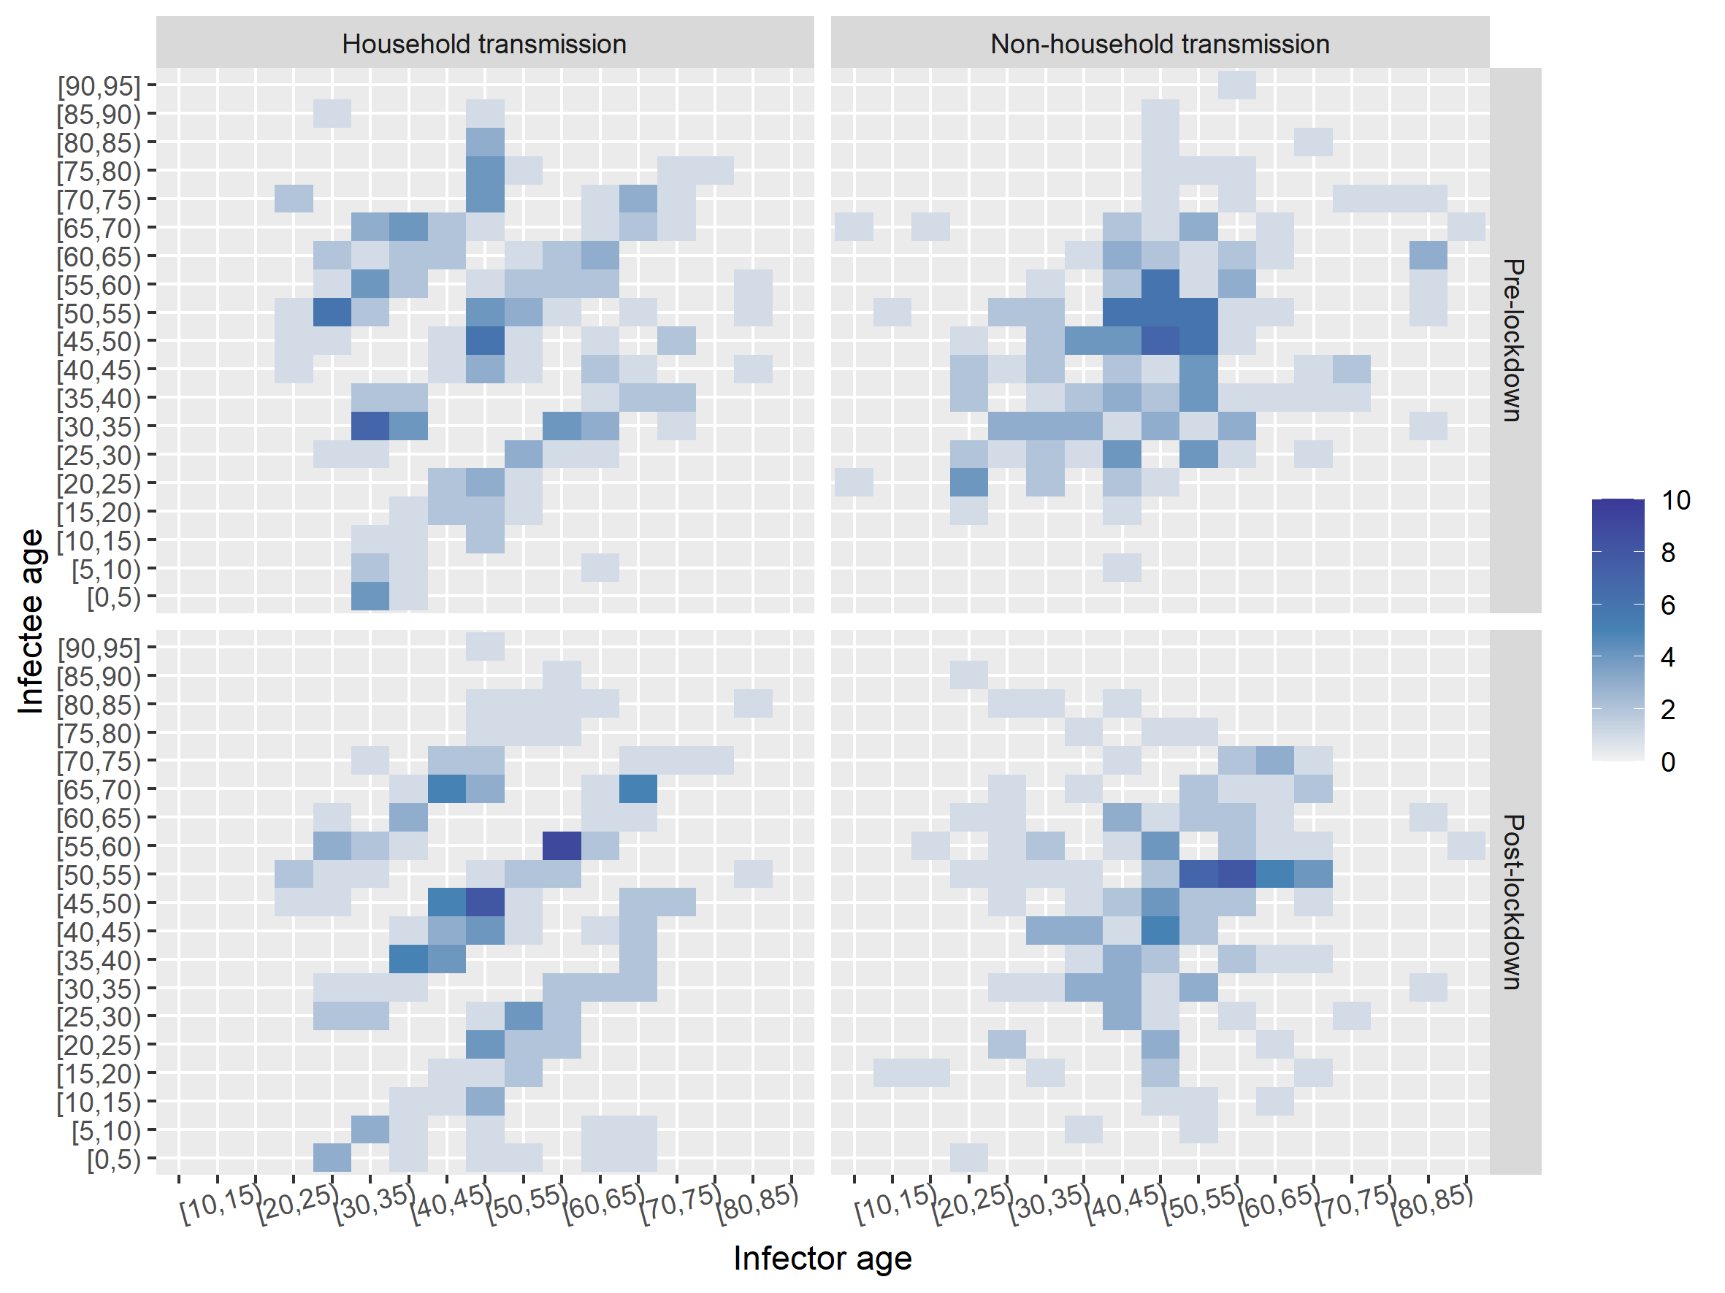
Before and after

Slide 19
Before and after

Slide 20
Before and after – bootstrap

Slide 21
Before and after – bootstrap randomised

